Slide 1
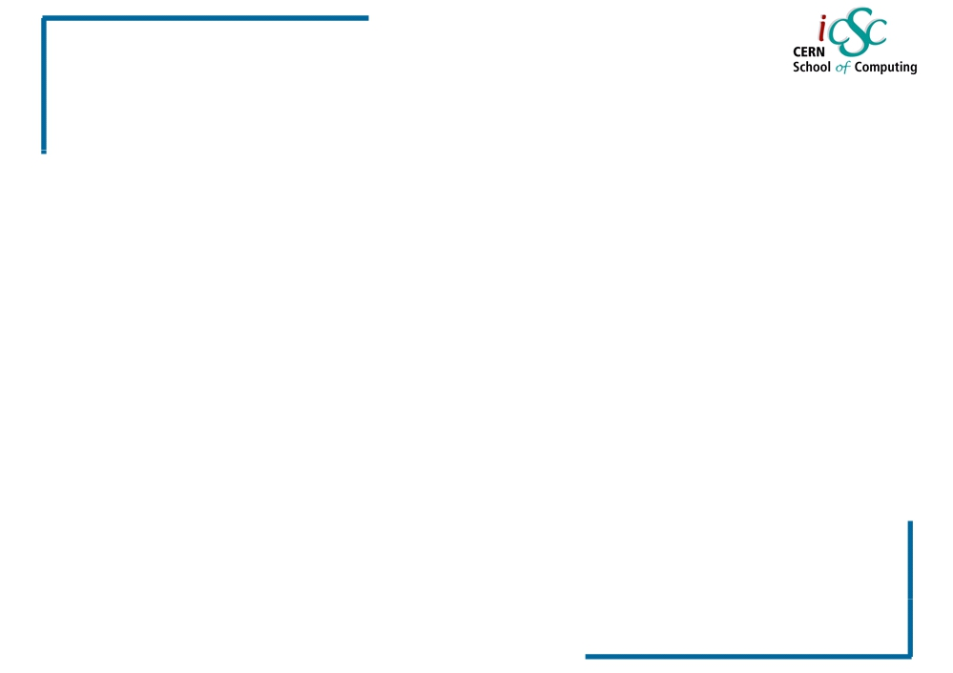
Virtualization
Virtualization
Carlos Garcia Fernandez, CERN Luigi Gallerani, CERN
Inverted CERN School of Computing, 3-4 March 2011
1
iCSC2011, Carlos Garcia Fernandez, CERN
Luigi Gallerani, CERN

Slide 2
Do I need an operating system on my computer?

Slide 3
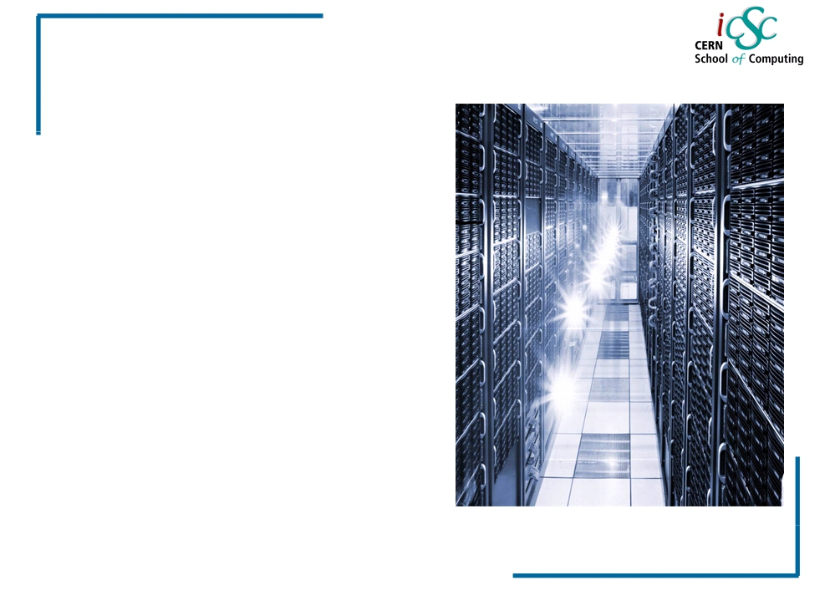
Virtualization
Virtualization
Carlos Garcia Fernandez Luigi Gallerani
carlos.garcia.fernandez@cern.ch luigi.gallerani@cern.ch
2
iCSC2011, Carlos Garcia Fernandez, CERN
Luigi Gallerani, CERN

Slide 4
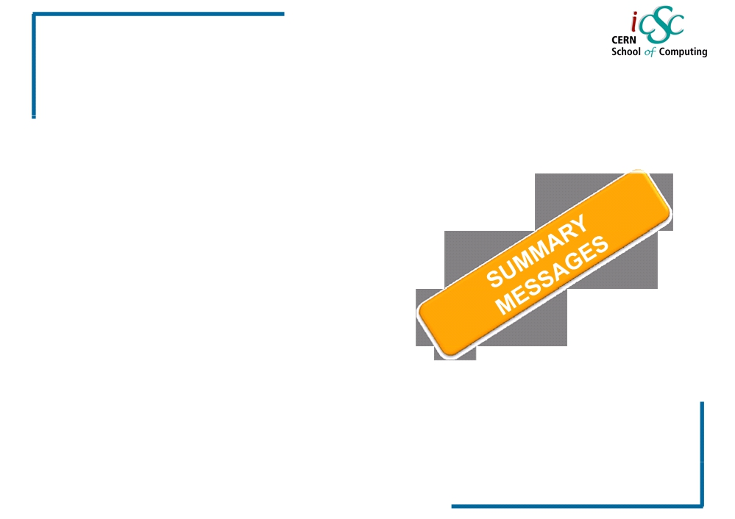
Virtualization
Outline
▪ Some definitions ▪ History
▪ Reason and benefits of Virtualization ▪ Virtualization techniques
▪ Hypervisor
▪ Server Virtualization
▪ Approaches for Virtualization
Source: Wikipedia
3
iCSC2011, Carlos Garcia Fernandez, CERN
Luigi Gallerani, CERN

Slide 5
Terminologies
Platform?
It is a computer system (Operating system) on which application programs can run. It is a base for hardware and software.
Example: MS 2000 and Mac OS X
Process?
In computing, a process is an instance of a computer program that is being executed.
It contains the program code and its current activity.
Depending on the operating system(OS), a process may be made up of multiple threads of executions that execute instructions concurrently.

Slide 6
Virtualization
Some concepts and history
4
iCSC2011, Carlos Garcia Fernandez, CERN
Luigi Gallerani, CERN

Slide 7
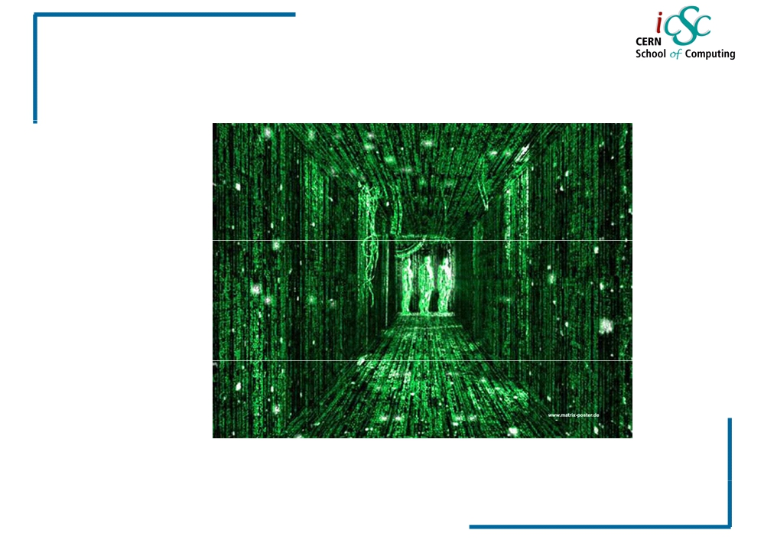
Virtualization
What is “virtual”?
5
iCSC2011, Carlos Garcia Fernandez, CERN
Luigi Gallerani, CERN

Slide 8
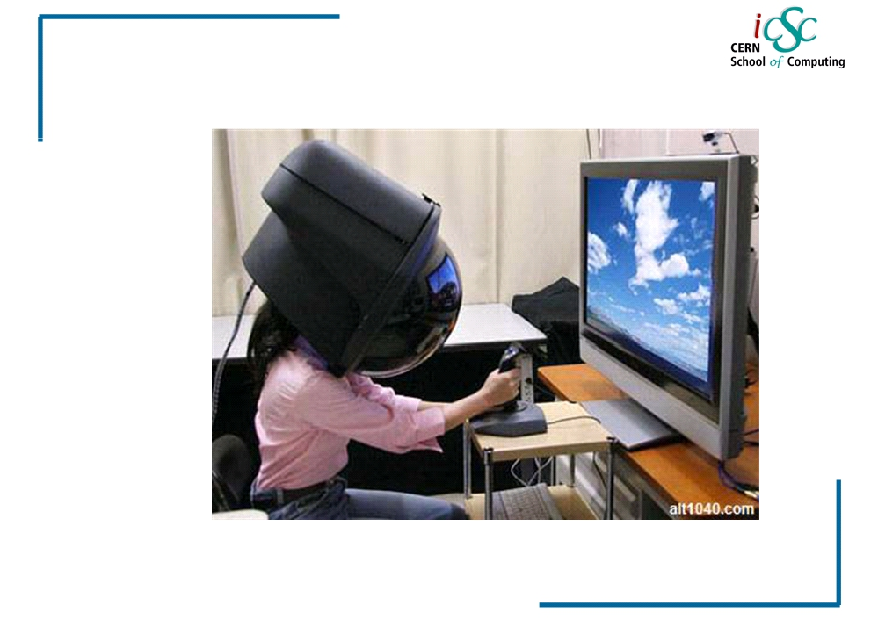
Virtualization
What is “virtual”?
6
iCSC2011, Carlos Garcia Fernandez, CERN
Luigi Gallerani, CERN

Slide 9
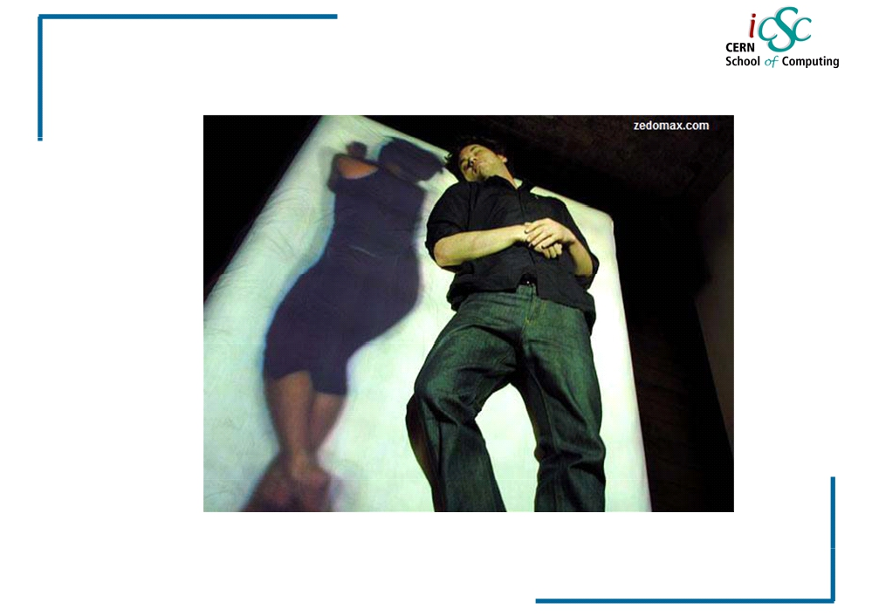
Virtualization
What is “virtual”?
7
iCSC2011, Carlos Garcia Fernandez, CERN
Luigi Gallerani, CERN

Slide 10
Virtualization
Definitions @ Computer Science
Virtual:
Created, simulated, or carried on by means of a computer or a computer network
Virtualization:
Virtualization is the creation of a virtual version of something, such as an operating system, a server, a storage device or network resources.
Virtual Machine:
A virtual machine (VM) is a software implementation of a machine (a computer) that executes programs like a physical machine.
8
iCSC2011, Carlos Garcia Fernandez, CERN
Luigi Gallerani, CERN

Slide 11
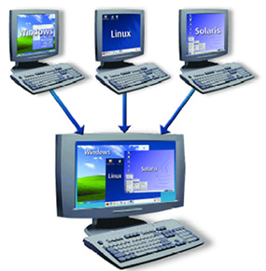
Virtualization
PHYSICAL COMPUTER

Slide 12
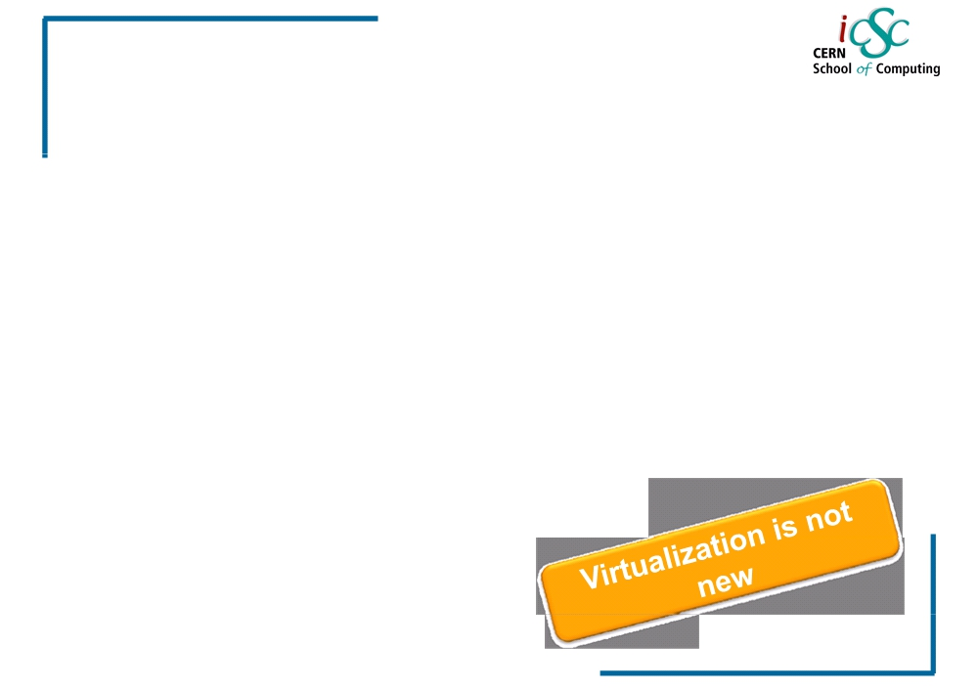
Virtualization
The beginning
•1960s
IBM creates this concept to fully utilize Mainframe hardware by logically partitioning them into virtual machines.
•1980s - 1990s,
Desktop computing and x86 servers become
available and so the virtualization technology was discarded
eventually
•1990s,
VMWare invented virtualization for the x86 architecture.
• Main objective:
Portability of applications
Isolation
Integration /deployment
(solving dependencies)
9
iCSC2011, Carlos Garcia Fernandez, CERN
Luigi Gallerani, CERN

Slide 13
Virtualization
Reasons and benefits
Of
Virtualization
10
iCSC2011, Carlos Garcia Fernandez, CERN
Luigi Gallerani, CERN

Slide 14
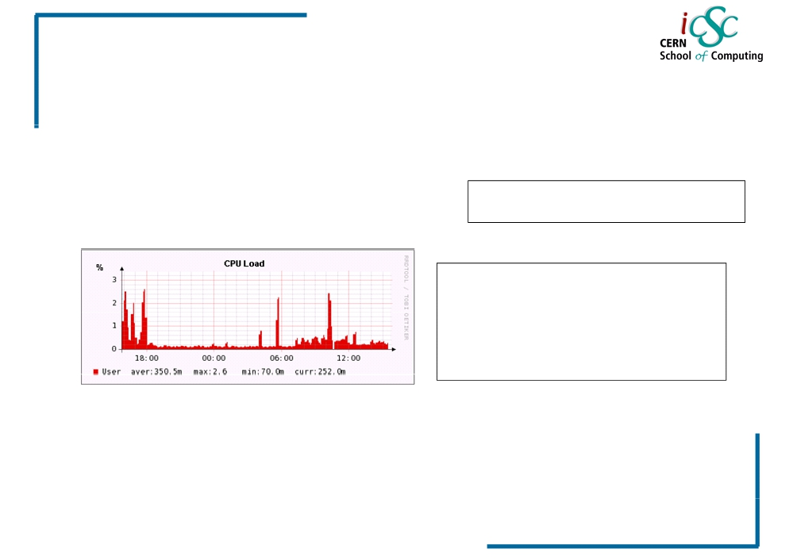
Virtualization
Reasons & Benefits of virtualization
▪ Low Infrastructure Utilization, more powerful hardware
International Data Co-operation (IDC)
Average hardware utilization: 10%-15%
Some CERN real cases: <5%
Pre‐virtualization machines: ‐ 8 GB RAM
Virtualization host machines: ‐ 48 GB RAM
▪ Decreasing Physical Infrastructure Costs
IDC: International Data Corporation, is a market research firm
iCSC2011, Carlos Garcia Fernandez, CERN
Luigi Gallegan, CERN
11

Slide 15
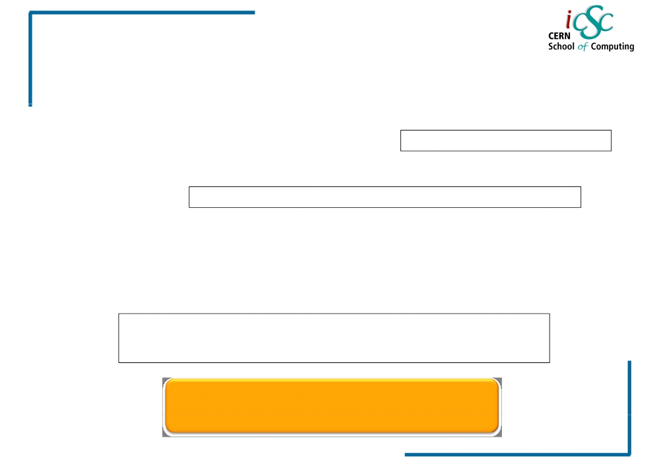
Virtualization
Reasons & Benefits of virtualization
▪ Relocation from one physical machine to another as needed, helping with Failover and Disaster Protection
Reality: Power cut December 2010
▪ Insufficient Physical Space in Data Centers
Reality: Our bigger pool: 5 Physical Machines - ~40 Virtual Machines
▪ High Maintenance end-user desktops
▪ Server consolidation: P2V transformation
Reality: Virtual Machines are identical to Physical Machines, but more flexible
- Installation and configuration
- Usability
Underutilized and wasted resources
12
iCSC2011, Carlos Garcia Fernandez, CERN
Luigi Gallerani, CERN

Slide 16
Virtualization Benefits
Run Multiple Operating system on a single computer including Windows, Linux and more.
Let your Mac run Windows creating a virtual PC environment for all your Windows applications.
Reduce capital Costs by increasing Energy efficiency and requiring less hardware while increasing your server to admin ratio
Ensure your enterprise applications perform with the highest availability and performance
Improve enterprise desktop management & control with faster deployment of desktops and fewer support calls due to application conflicts

Slide 17
Virtualization
More concepts
13
iCSC2011, Carlos Garcia Fernandez, CERN
Luigi Gallerani, CERN

Slide 18
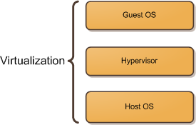
Virtualization concept
Host OS: Windows 7
The host operating system provides a host to one or more virtual machines (or partitions) and shares physical resources with them.
Guest OS: Windows XP or Linux OS
The guest OS is the operating system installed inside a virtual machine (or a partition).
Hypervisor:
Also called a Virtual Machine Manager (VMM), is a program that allows multiple operating systems to share a single hardware host
Windows XP
Linux
Windows 7

Slide 19
What can be virtualized?
Network
Storage
Servers
Hardware
Desktop computer

Slide 20
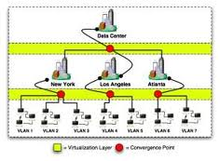
Network Virtualization
splits up the available bandwidth into channels, each of which is independent from the others, and each of which can be assigned to a particular server or device in real time.

Slide 21
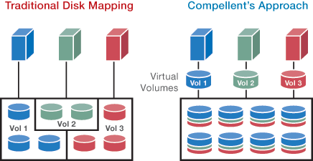
Storage Virtualization
Is the pooling of physical storage from multiple network storage devices into what appears to be a single storage device. It is commonly used in storage area networks (SANs).

Slide 22
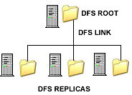
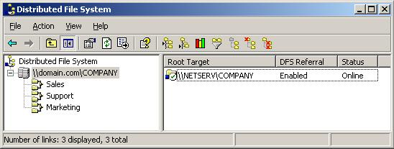
Microsoft Distributed File System

Slide 23
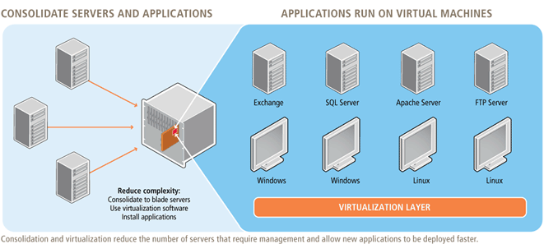
Server virtualization
Is the idea of taking a physical server and partition it, or divide it up, so that it appears as several “virtual servers”, each of which can run their own copy of an OS. The main purpose of this approach is ISOLATION.

Slide 24
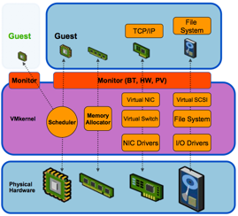
Hardware Virtualization

Slide 25
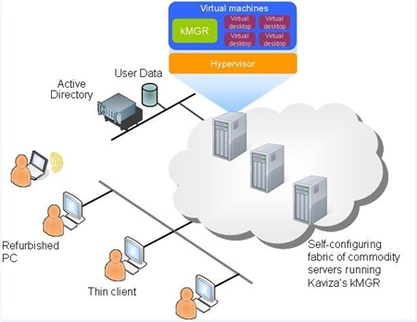
Desktop Virtualization

Slide 26
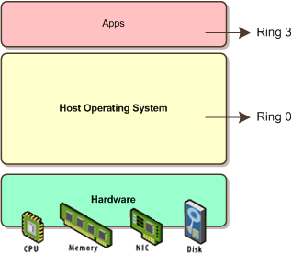
Traditional virtualization
Here the OS sits on the hardware and on ring 0.
OS CORE

Slide 27
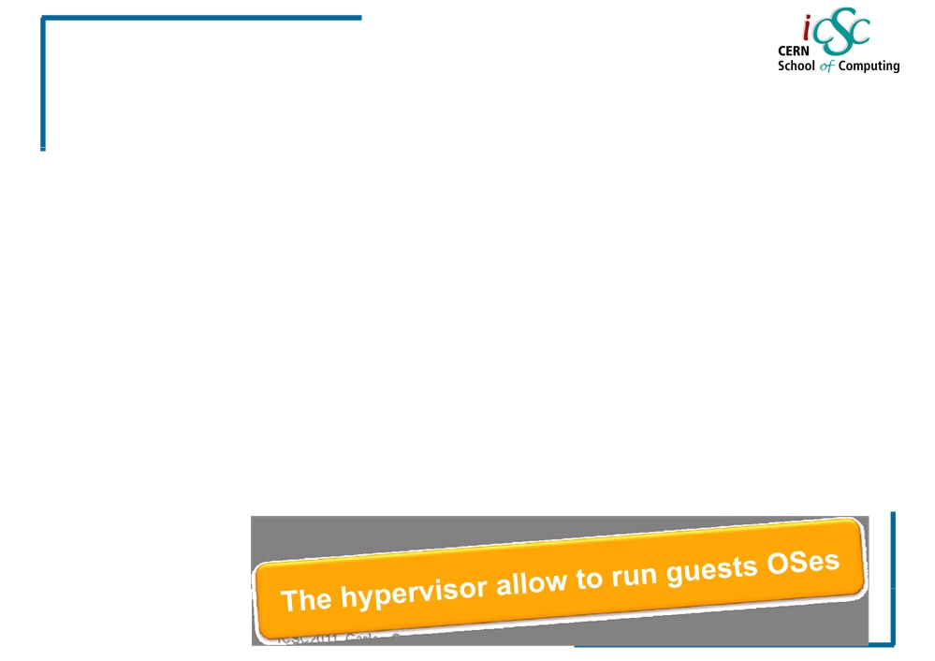
Hypervisor
Virtualization
• Also called Virtual Machine Monitor (VMM) or Virtualization Manager
Concept:
Software program or part of the code in firmware that manages either multiple OS or multiple instances of the same OS on a single computer system
• What is controlled by the hypervisor:
• CPU
• Memory
• Other resources required by the operating system
• It validates all the guest-issued CPU instructions and manages any executed code that requires additional privileges.
15
iCSC2011, Carlos Garcia Fernandez, CERN
Luigi Gallerani, CERN

Slide 28
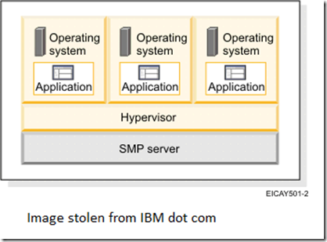
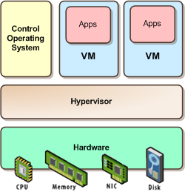
Types of Hypervisor: Type 1 and type2
Type 1 : Bare Metal
hypervisors are those that run directly on the host system hardware and offer a higher level of virtualization efficiency and security. ESX, Xen, and Hyper-V Faster performance.

Slide 29
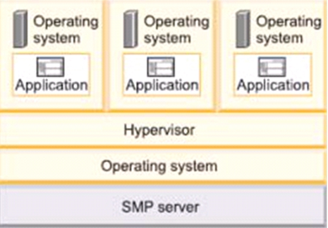
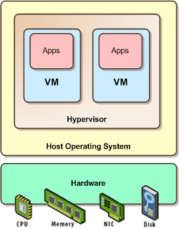
Types of Hypervisor
Type 2: Hosted
Hypervisors are those that run on a host operating system. It provides virtualization services, such as I/O device support and memory management. Ex: Microsoft´s Virtual PC, and VMWare´s Workstation. Slower performance.

Slide 30
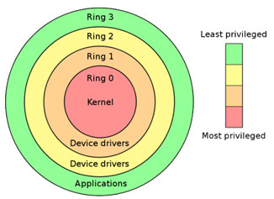
Needed concept: Protection Rings
Concept: Mechanism to set the layers of privilege used to protect the data and the functionality.
Ring 0 or Kernel: Can execute any CPU
instruction and reference any memory
address.
Ring 3: The access to hardware and
memory reference needs to be arbitrated.
Hypervisor: handles the resource
and memory allocation for the
virtual machines
Guest’s kernels: run in outer rings
but they might be written to run in Ring 0
X86 Priority modes

Slide 31
Virtualization
Virtualization Techniques
19
iCSC2011, Carlos Garcia Fernandez, CERN
Luigi Gallerani, CERN

Slide 32
Virtualization
Virtualization Techniques
▪ Emulation
▪ Full Virtualization
▪ OS-level virtualization ▪ Para virtualization
Host OS: The actual computer with an OS(physical computer)
Guest OS: An OS sitting in an actual computer (logical computer)
20
iCSC2011, Carlos Garcia Fernandez, CERN
Luigi Gallerani, CERN

Slide 33
Virtualization
Emulation
▪ Concept: VM Emulates/simulates complete hardware.
▪ Unmodified guest OS for a different PC can be run
It is possible to emulate an architecture in a completely different one
It makes a fake hardware environment for the VM, like Nintendo 64
▪ What runs where?
▪ Ring 0: runs the host
▪ Ring 3: runs the guest OS (as applications)
▪ Cons: Very slow because of not native execution ▪ Examples: Bochs, Virtual PC for Mac, QEMU
21
iCSC2011, Carlos Garcia Fernandez, CERN
Luigi Gallerani, CERN

Slide 34
Emulator benefit
Emulators maintain the original look, feel, and behavior of the digital object
Despite the original cost of developing an emulator, it may cost efficient solution over time.
Reduces labor hours. Like data migration
Emulators allow video games exclusive to one system to be played on another. For example, a PlayStation 2 exclusive video game could (in theory) be played on a PC or Xbox 360 using an emulator.

Slide 35
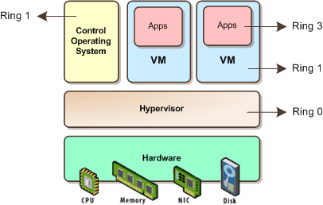
Full Virtualization:
Virtualization
▪ Concept: The host OS emulates a hardware layer for each guest OS
▪ What runs where?
▪ Ring 0: run the guest OS privileged operations
Hypervisor provides CPU emulation to handle it
▪ Pros: Stability, guest OS doesn’t need modifications ▪ Cons: System Resources, time performance
Examples:
IBM’s VM family, VMWare Workstation, …
Full virtualization is used to simulate a complete hardware environment, or virtual machine, in which an unmodified guest operating system (using the same instruction set as the host machine) executes in complete isolation.
22
iCSC2011, Carlos Garcia Fernandez, CERN
Luigi Gallerani, CERN

Slide 36
Difference between Emulator and Virtualization
Emulator
Virtualization
Emulates hardware only
Very slow
Needs power full hardware
Copies hardware and software
Very fast

Slide 37
Virtualization
OS-level Virtualization
The physical server and single instance of the operating system is virtualized into multiple isolated partitions, where each partition replicates a real server. The OS kernel will run a single operating system and provide that operating system functionality to each of the partitions.
▪ Concept: Same OS for host and guests and only isolation in the user land (operating system software that does not belong in the kernel/ring 0).
If you run `ps aux` in the host, you will see all guest processes
Ps aux = process status in Unix (similar function as a task manager in Windows)
What runs where?
Ring 0: run the OS (same for all)
Pros: Low overhead, highest performance
Cons: Isolation, stability
Examples: FreeBSD Jails, Solaris Containers, Virtuzzo/OpenVZ
23
iCSC2011, Carlos Garcia Fernandez, CERN
Luigi Gallerani, CERN

Slide 38
Virtualization
Para-virtualization (I)
▪ Concept: The hypervisor, interfaces the hardware to all OS’s (host and guest)
• Guests are modified to run on the hypervisor
▪ Replacement of privileged operations (ring0) with calls to the hypervisor
▪ What runs where?
▪ Ring 0: run an hypervisor
▪ Ring 1: run the guest OS
▪ Ring 3: run the applications
In theory Para-virtualization (where the guest kernel knows that it’s running on a hypervisor, not “real” hardware) is faster than pure hardware virtualization.
24
iCSC2011, Carlos Garcia Fernandez, CERN
Luigi Gallerani, CERN

Slide 39
Virtualization
Paravirtualization (II)
• Pros:
- Stability is very good
- Performance is very good (nothing can beat OS-level virtualization in this matter)
- Overhead is very low
• Cons:
- Not easy to implement (it’s getting better these days)
- Both host and guest kernels have to be patched
- Maintainability
• Example: XEN, VMWare, ESX server
25
iCSC2011, Carlos Garcia Fernandez, CERN
Luigi Gallerani, CERN

Slide 40
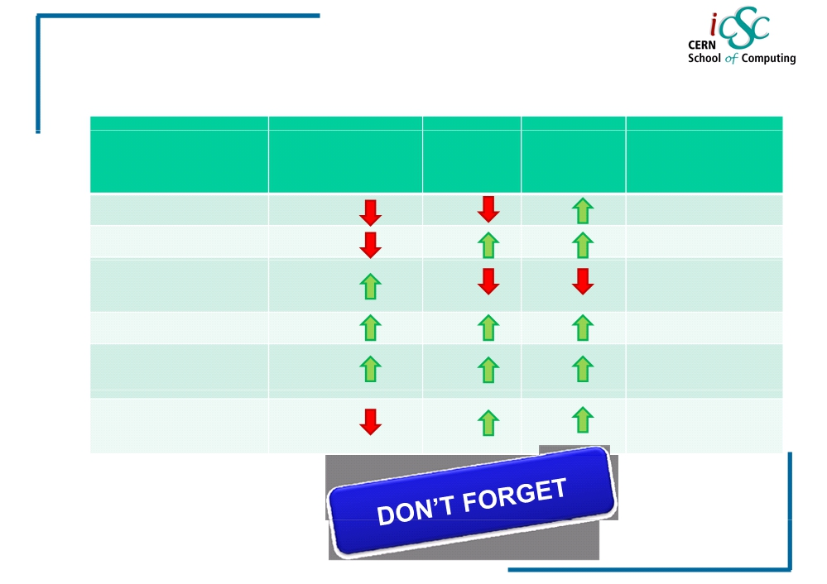
Virtualization
Comparison table
Performance
Stability
Isolation
Modifications?
/ HW support?
Emulation Full Virtualization
No/No No/No
-
OS-level
No/No
virtualization
Paravirtualization
+
Yes/No
Hardware-assited
+
No/Yes
Virtualization
Application level
No/No
virtualization
29
iCSC2011, Carlos Garcia Fernandez, CERN
Luigi Gallerani, CERN

Slide 41
Virtualization
Server Virtualization
30
iCSC2011, Carlos Garcia Fernandez, CERN
Luigi Gallerani, CERN

Slide 42
Virtualization
Server Virtualization
▪ Concept:
▪ Is the idea of taking a physical server and partition it, or divide it up, so that it appears as several “virtual servers”, each of which can run their own copy of an OS.
31
iCSC2011, Carlos Garcia Fernandez, CERN
Luigi Gallerani, CERN

Slide 43
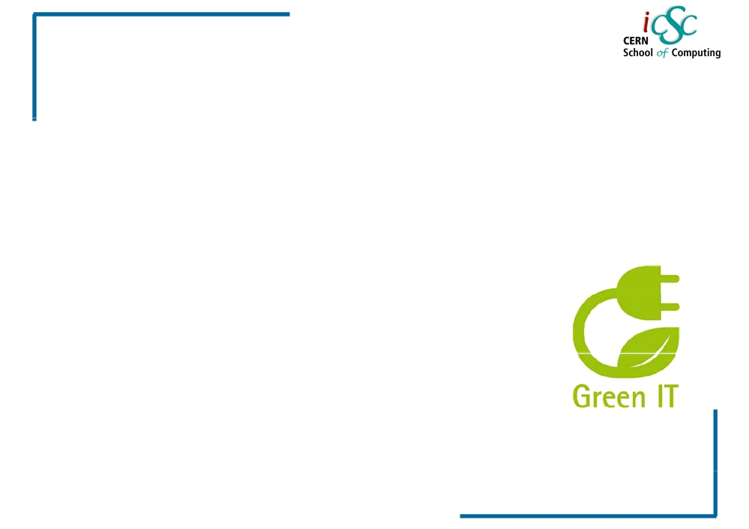
Virtualization
Why is it so popular?
▪ Multiple operating system instances at once on a single physical server.
▪ Reduce the number of physical servers and in consequence physical space in data centers
▪ Offers higher availability
▪ Cut down on energy consumption
▪ Eases the maintenance and patching
32
iCSC2011, Carlos Garcia Fernandez, CERN
Luigi Gallerani, CERN

Slide 44
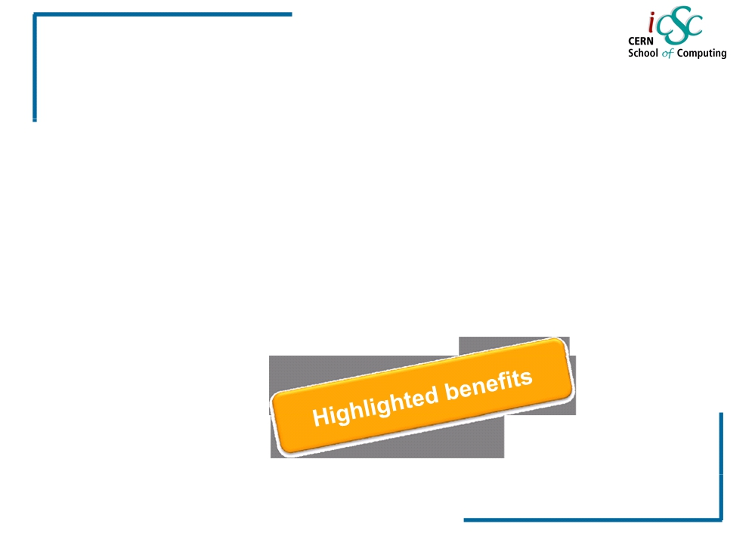
Virtualization
Server Virtualization Landscape
▪ As of October 2009, only 16 % of server workloads were running on VMs
▪ Gartner predicted that the numbers would rise to approximately 50 % of workloads (x86 architecture) by the end of 2012 - or about 58 million deployed machines
33
Source: Gartner
iCSC2011, Carlos Garcia Fernandez, CERN
Luigi Gallerani, CERN
Inc

Slide 45
Virtualization
Practical Approaches
35
iCSC2011, Carlos Garcia Fernandez, CERN
Luigi Gallerani, CERN

Slide 46
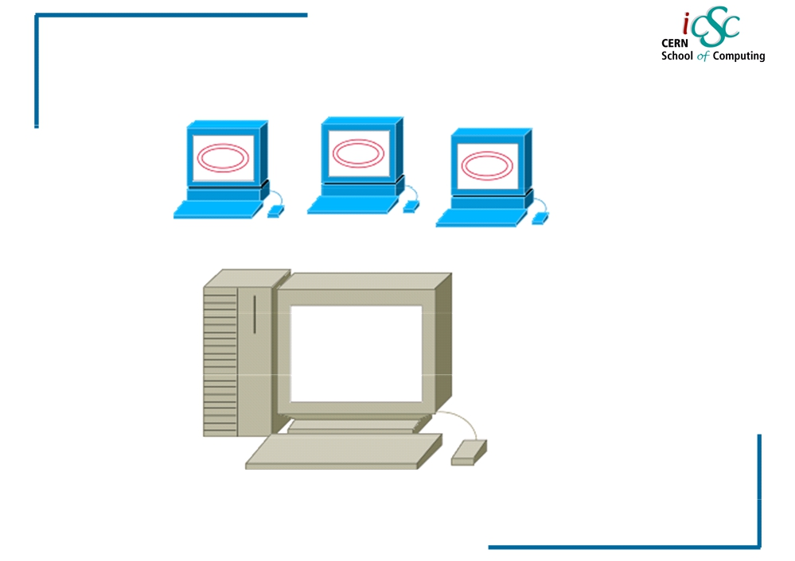
Virtualization
Simple Virtualization 😐
Virtual
Machines
Physical
Hypervisor
36
iCSC2011, Carlos Garcia Fernandez, CERN
Luigi Gallerani, CERN

Slide 47
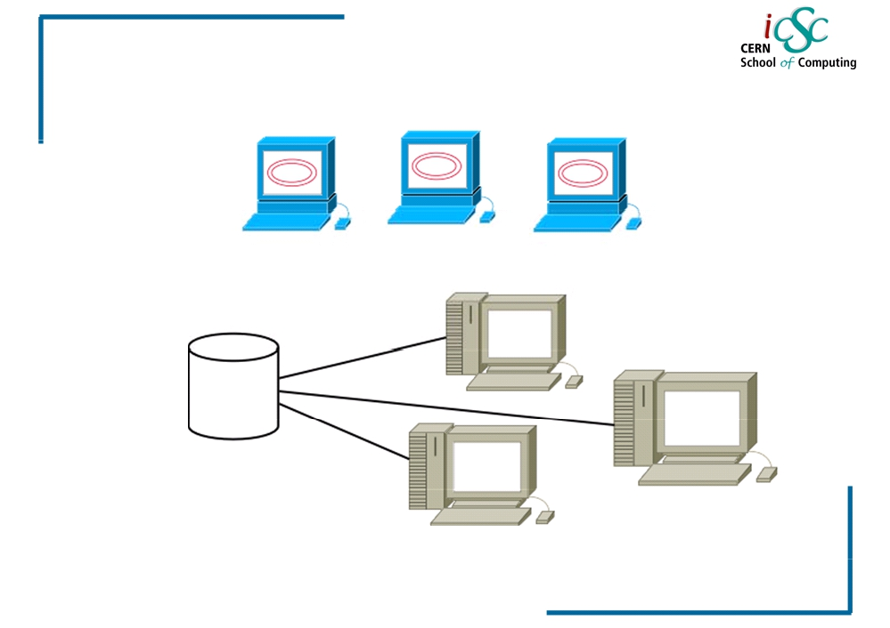
Virtualization
More virtual approach ☺
Multiple
Hypervisors
Vm image in a network storage
37
iCSC2011, Carlos Garcia Fernandez, CERN
Luigi Gallerani, CERN

Slide 48
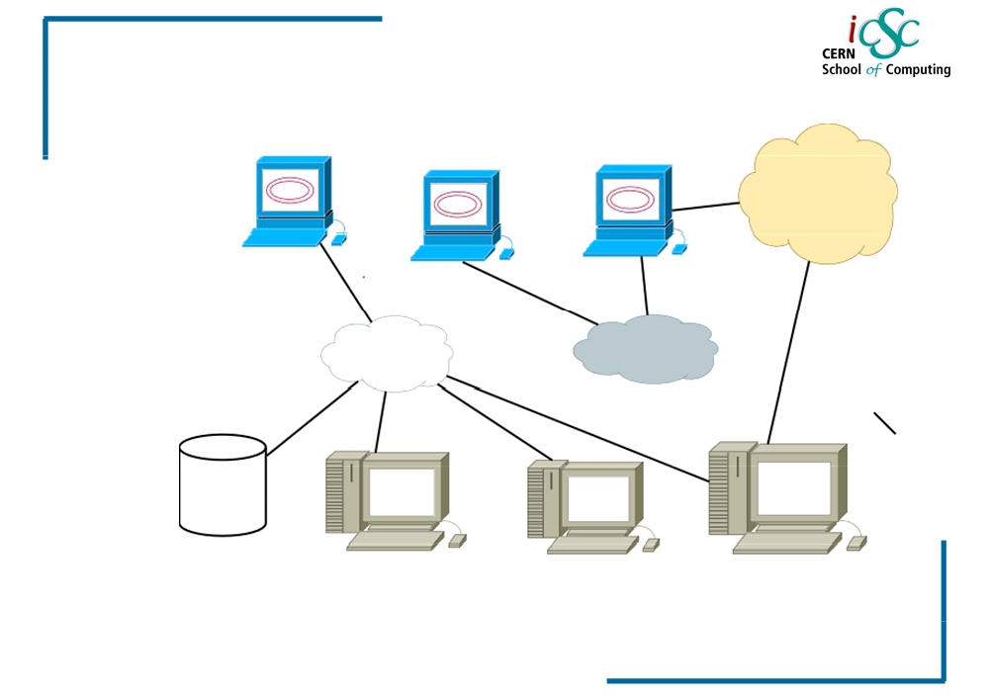
Virtualization
Virtual networking
BETA
ALPHA
GAMMA
1 ETH ALPHA
1 ETH 1 ETH
ALPHA 1 ALPHA
ETH BETA
38
iCSC2011, Carlos Garcia Fernandez, CERN
Luigi Gallerani, CERN

Slide 49
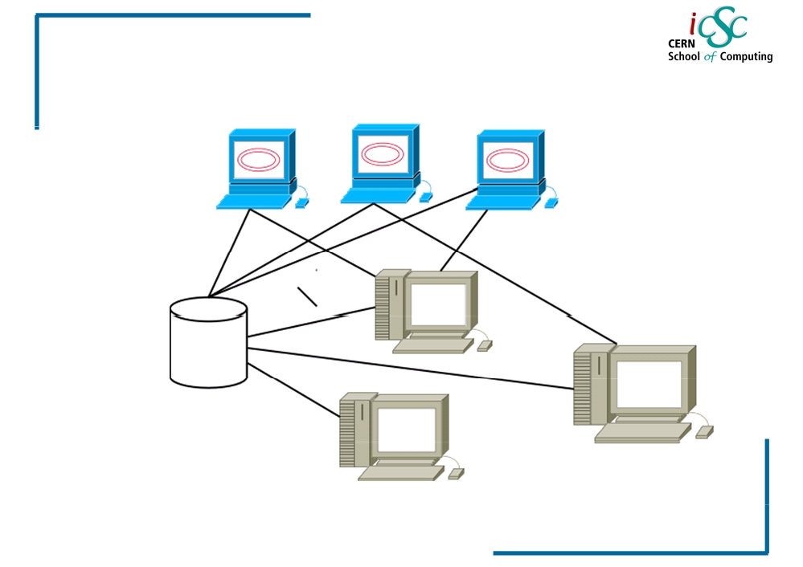
Virtualization
Management scenario ☹
WHERE
ARE
MY VM
MACHINE
RUNNING?
39
iCSC2011, Carlos Garcia Fernandez, CERN
Luigi Gallerani, CERN

Slide 50
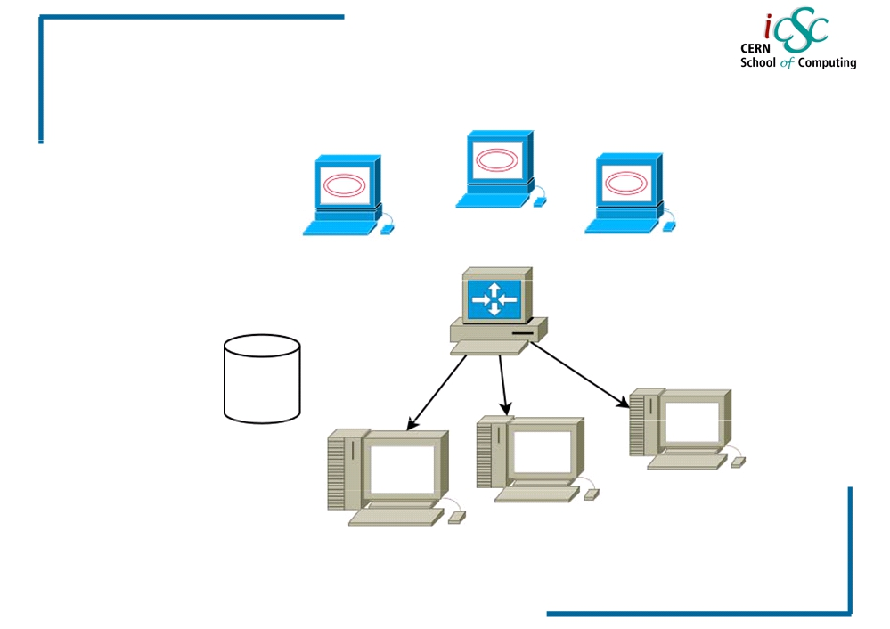
Virtualization
VM Manager ☺
VM
MANAGER
40
iCSC2011, Carlos Garcia Fernandez, CERN
Luigi Gallerani, CERN

Slide 51
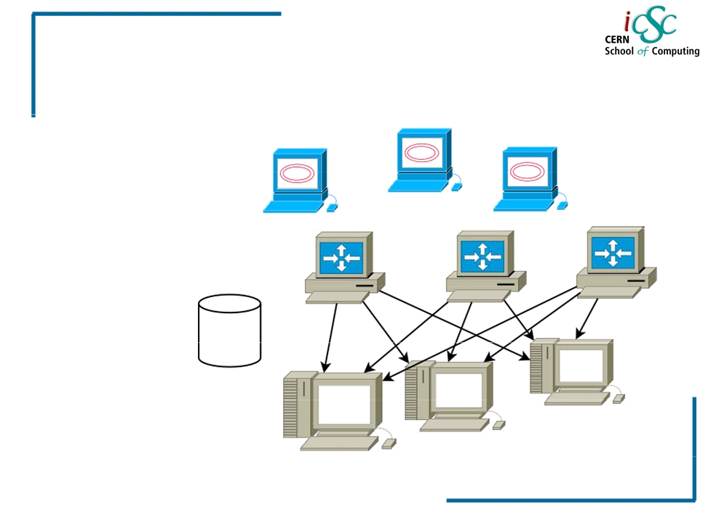
Virtualization
More virtual approach ☺☺
MULTIPLE
VM
MANAGERS
41
iCSC2011, Carlos Garcia Fernandez, CERN
Luigi Gallerani, CERN

Slide 52
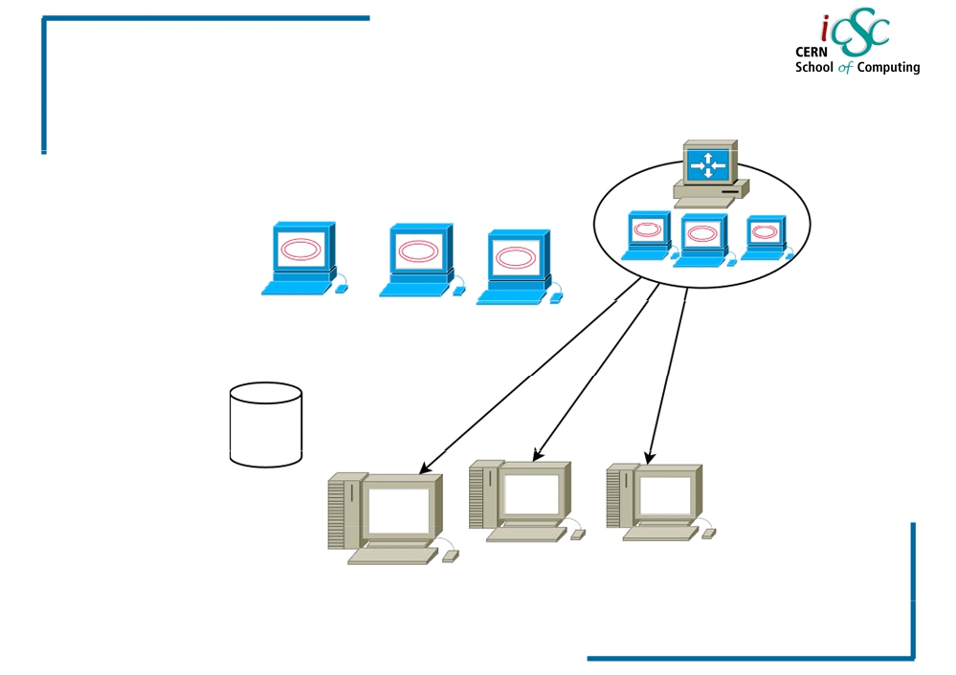
Virtualization
Full virtual approach
MANAGER
CLUSTER/POOL
VM
MANAGER
ON MULTIPLE VIRTUAL
MACHINES!!
42
iCSC2011, Carlos Garcia Fernandez, CERN
Luigi Gallerani, CERN

Slide 53
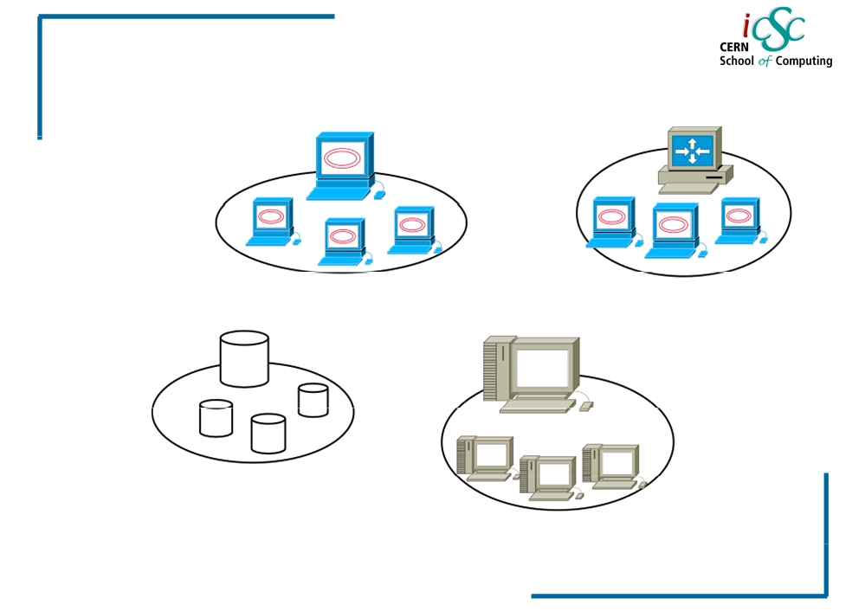
Virtualization
Resource clusters/pools
VM POOL CLUSTER
VM
MANAGER CLUSTER
STORAGE CLUSTER
PHYSICAL CLUSTER
43
iCSC2011, Carlos Garcia Fernandez, CERN
Luigi Gallerani, CERN

Slide 54
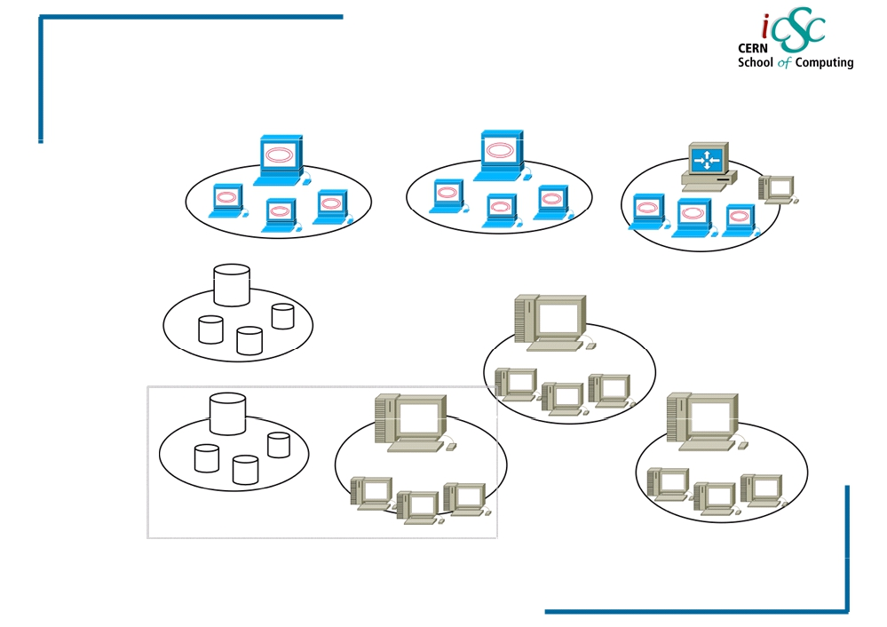
Virtualization
More virtual again!
DISTRIBUTED
APPROACH
RACK - UNIT
44
iCSC2011, Carlos Garcia Fernandez, CERN
Luigi Gallerani, CERN

Slide 55
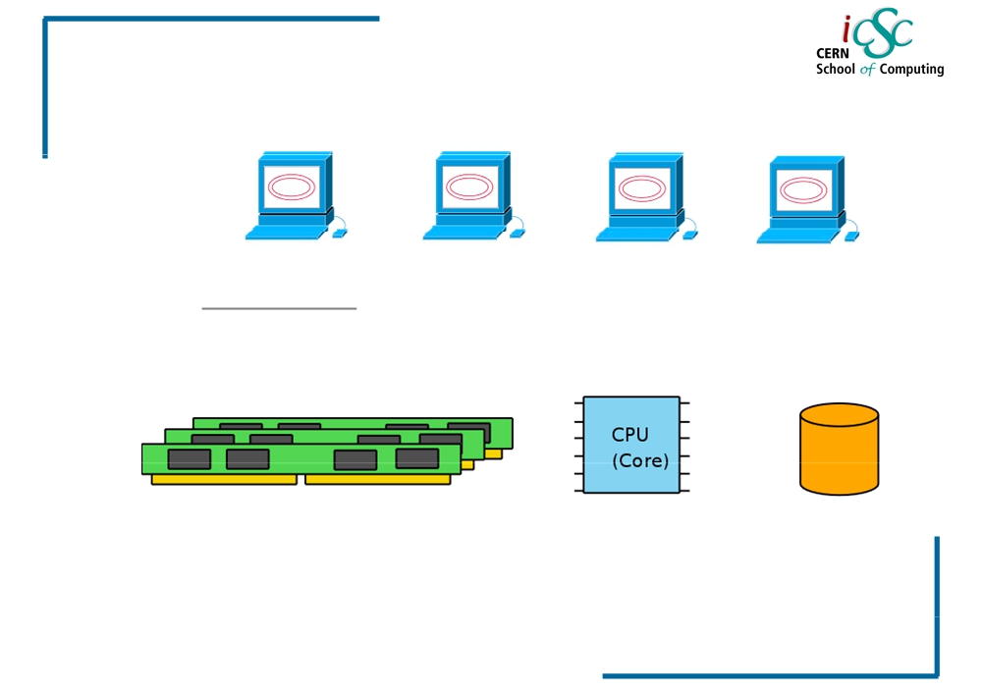
Virtualization
Virtualization ingredients
RUNNING EXISTING VIRTUAL MACHINES
MEMORY
CPU CORE Better if V optimized
STORAGE
45
iCSC2011, Carlos Garcia Fernandez, CERN
Luigi Gallerani, CERN

Slide 56
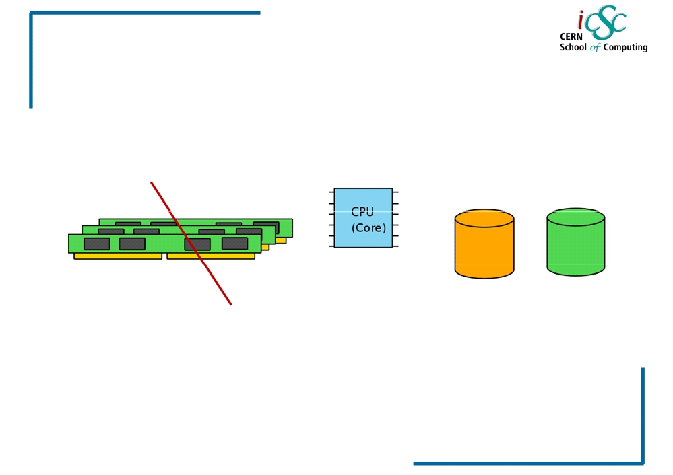
Virtualization
Running VM with no memory!
We can swap all the VM memory in a
physical disk, or we use the storage as a slow virtual memory
46
iCSC2011, Carlos Garcia Fernandez, CERN
Luigi Gallerani, CERN

Slide 57
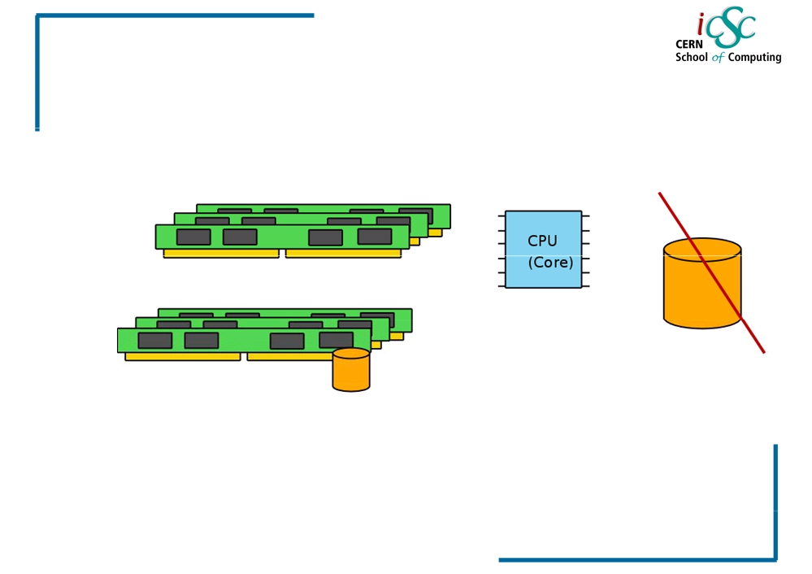
Virtualization
Running VM with storage!
We could use the memory as a physical
storage (tmpfs) for the Vm image. Extremely fast virtual machine!
47
iCSC2011, Carlos Garcia Fernandez, CERN
Luigi Gallerani, CERN

Slide 58
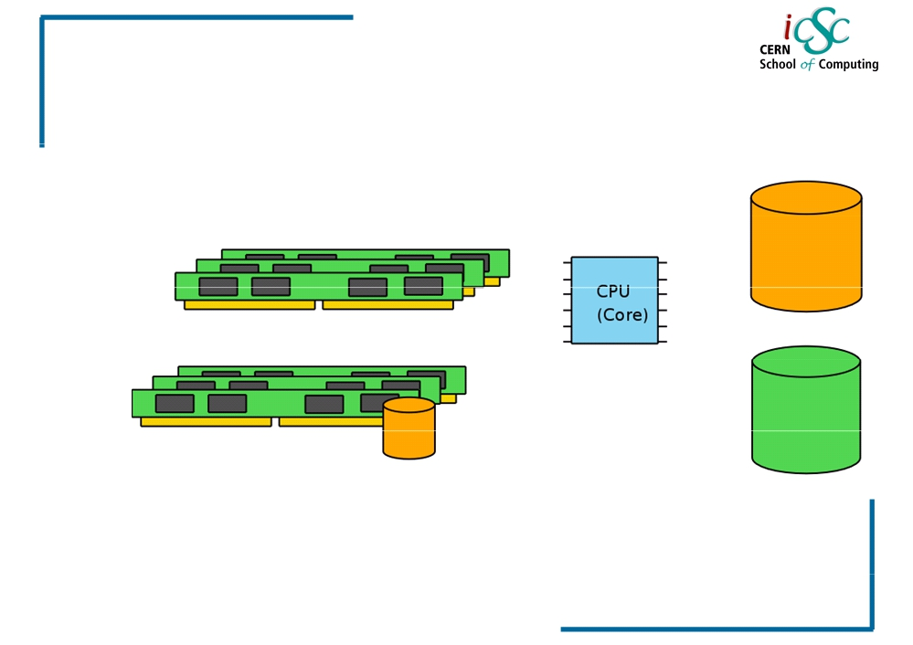
Virtualization
The full virtual approach
We use all the possible approaches in order to obtain what we want. The memory is really Virtual
49
iCSC2011, Carlos Garcia Fernandez, CERN
Luigi Gallerani, CERN

Slide 59
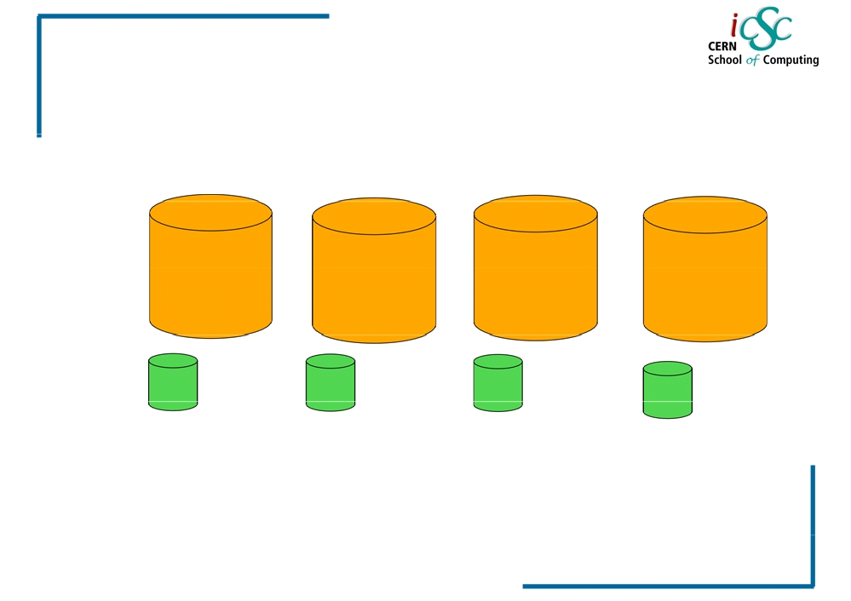
Virtualization
Disk image scenario
VM00
VM 01
VM02
VM##
VM DISK AND SWAP IMAGES
50
iCSC2011, Carlos Garcia Fernandez, CERN
Luigi Gallerani, CERN

Slide 60
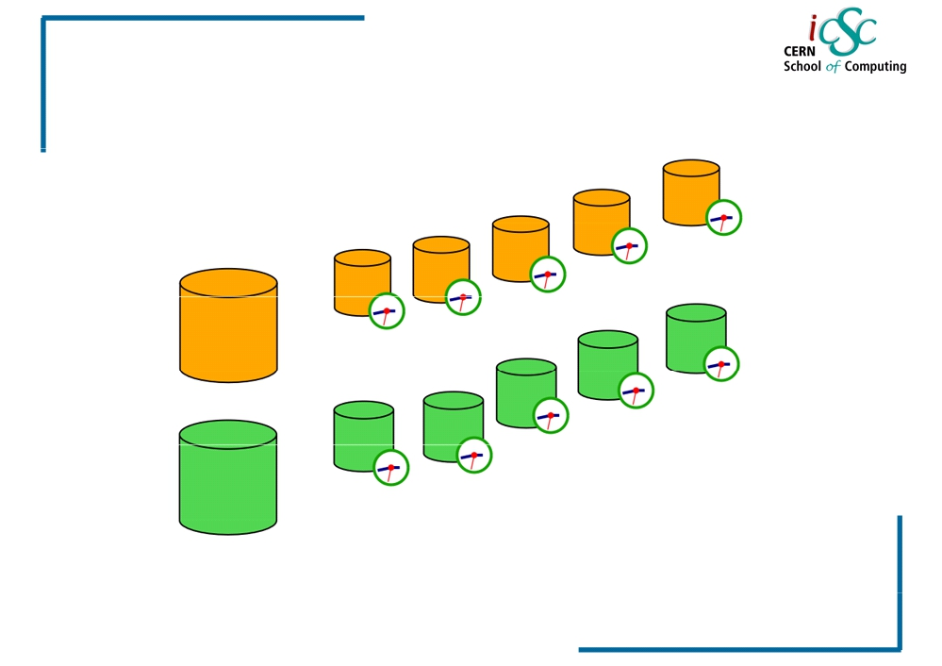
Virtualization
VM versions, time machine!
Using storage
snapshot technology we could have multiple
version of the same VMachine
52
iCSC2011, Carlos Garcia Fernandez, CERN
Luigi Gallerani, CERN

Slide 61
Virtualization
What about running without OS?
54
iCSC2011, Carlos Garcia Fernandez, CERN
Luigi Gallerani, CERN

Slide 62
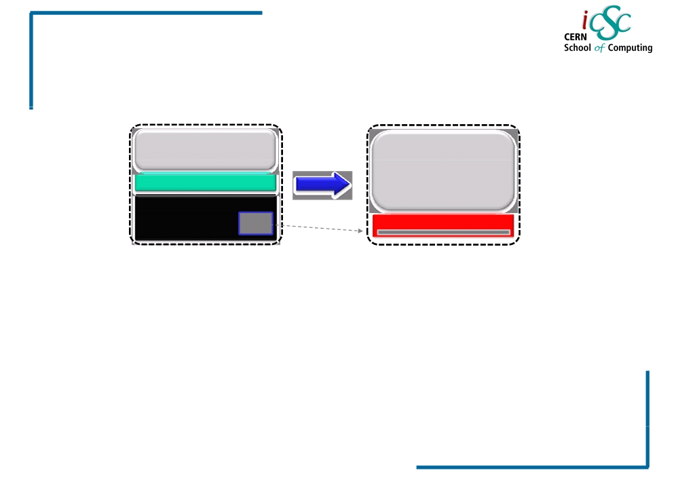
Virtualization
JRockit VE: Removing the OS and Creating a More Efficient Software Stack
VM with Standard Guest OS
VM with JRockit VE
Application
Application
JRockit JVM
OS File
JRockit VE
Net
•~1GB ‐> ~2 MB • Improved
• Customized to run single Java process
• No shell access allowed • Headless
performance • Simplified
configuration • Increased security
Slide from “Oracle JRockit - What’s new and what’s coming” @ OOW2009 © 2009 Oracle Corporation
55
iCSC2011, Carlos Garcia Fernandez, CERN
Luigi Gallerani, CERN

Slide 63
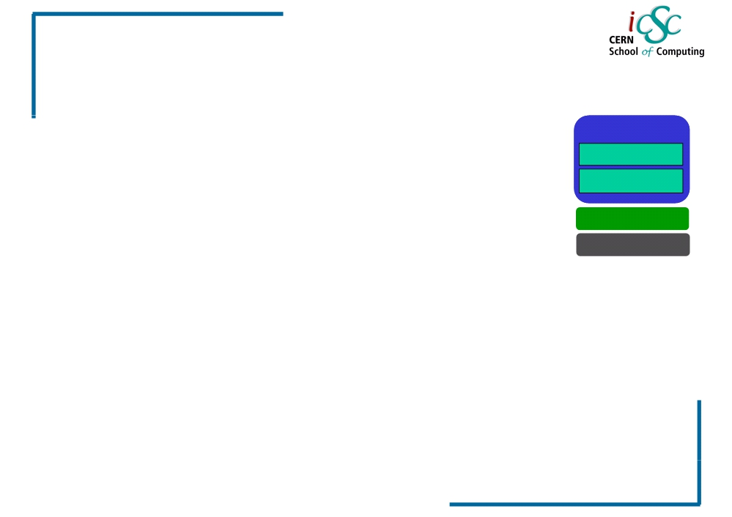
Virtualization
WebLogic Server Virtual Edition: Product Taxonomy
• WebLogic Server Virtual Edition
WLSVE
- Virtual machine containing WLS and JRockit VE
WLS
- Designed to run on Oracle VM,without an operating system
JRockit VE
- Users can create their own virtual machine images containing
WLSVE and their domains and applications
OVM x86
• JRockit VE
- JRockit VE is the JRockit JVM extended so it can run directly on virtual hardware, and optimized for running Java on OVM and
x86 hardware
• JRVE Image Tool
- Create and edit the virtual machine images
Slide from “Oracle JRockit - What’s new and what’s coming” @ OOW2009 © 2009 Oracle Corporation
56
iCSC2011, Carlos Garcia Fernandez, CERN
Luigi Gallerani, CERN

Slide 64
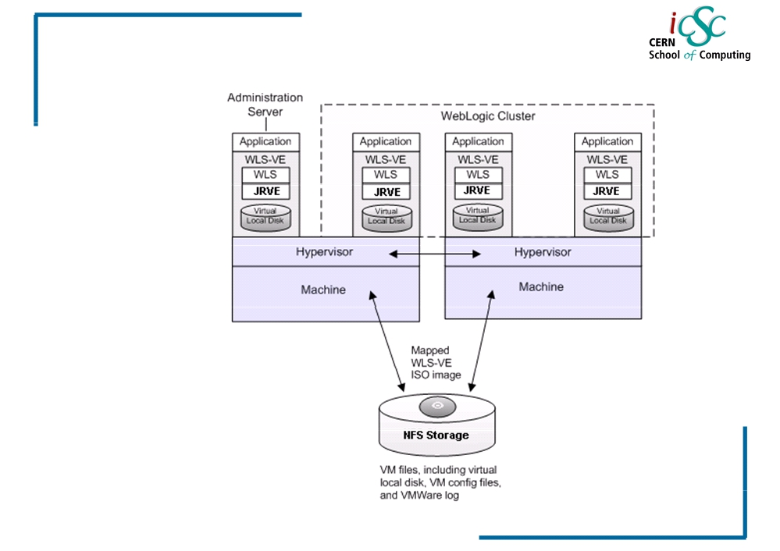
Virtualization
Example of WLS-VE topology
57
iCSC2011, Carlos Garcia Fernandez, CERN
Luigi Gallerani, CERN

Slide 65
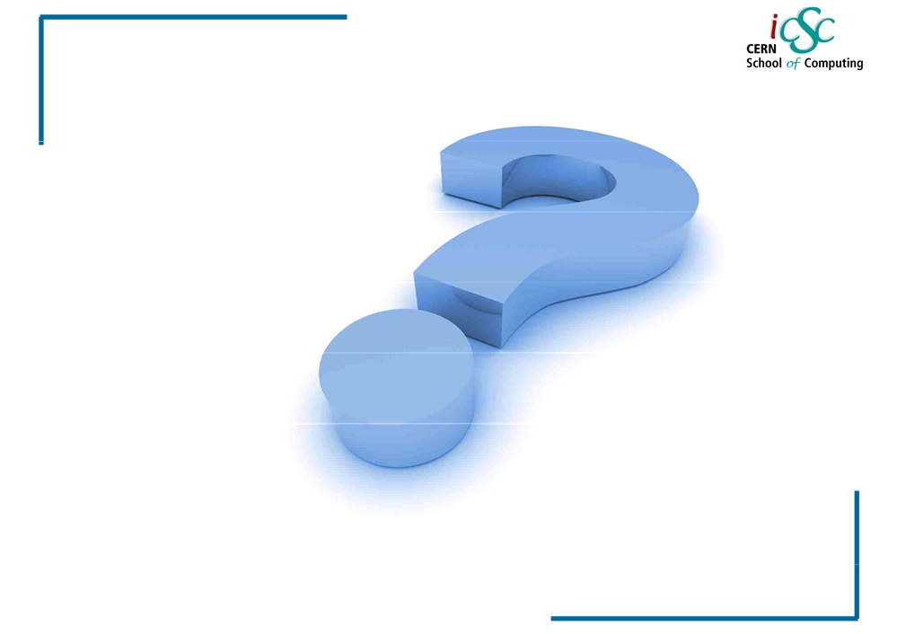
Virtualization
Questions?
Source:
▪ Wikipedia
▪ IBM Systems Virtualization Paper ▪ VMWare
▪ Giac.org
▪ About.com ▪ Oracle.com
58
iCSC2011, Carlos Garcia Fernandez, CERN
Luigi Gallerani, CERN

